Slide 1
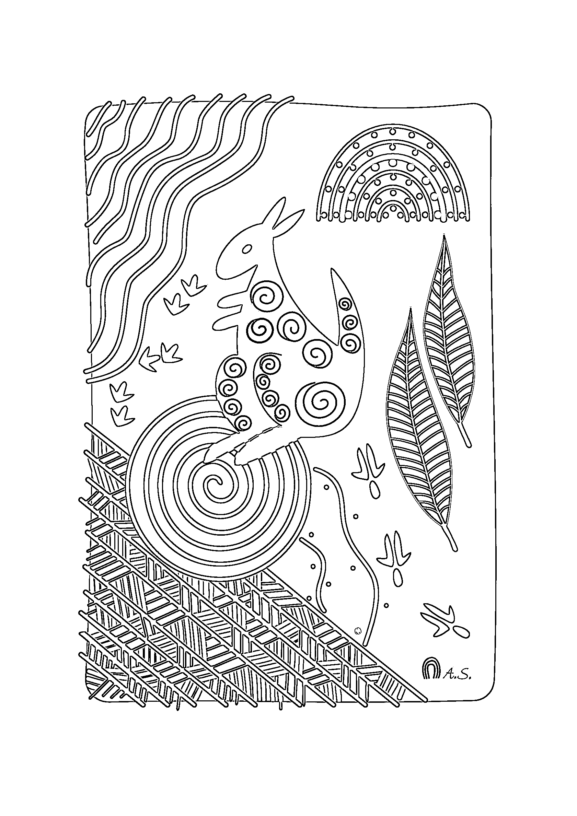
This Aboriginal Colouring In Sheet is a Gift from Annette Sax, Taungurung Artist.
Annette Sax holds © Copyright and does not give permission for her Aboriginal Art to be changed or adapted for any other purpose. She hopes that Children and Adults enjoy the experience of Colouring !
Visit our Website: www.yarnstrongsista.com

Slide 2
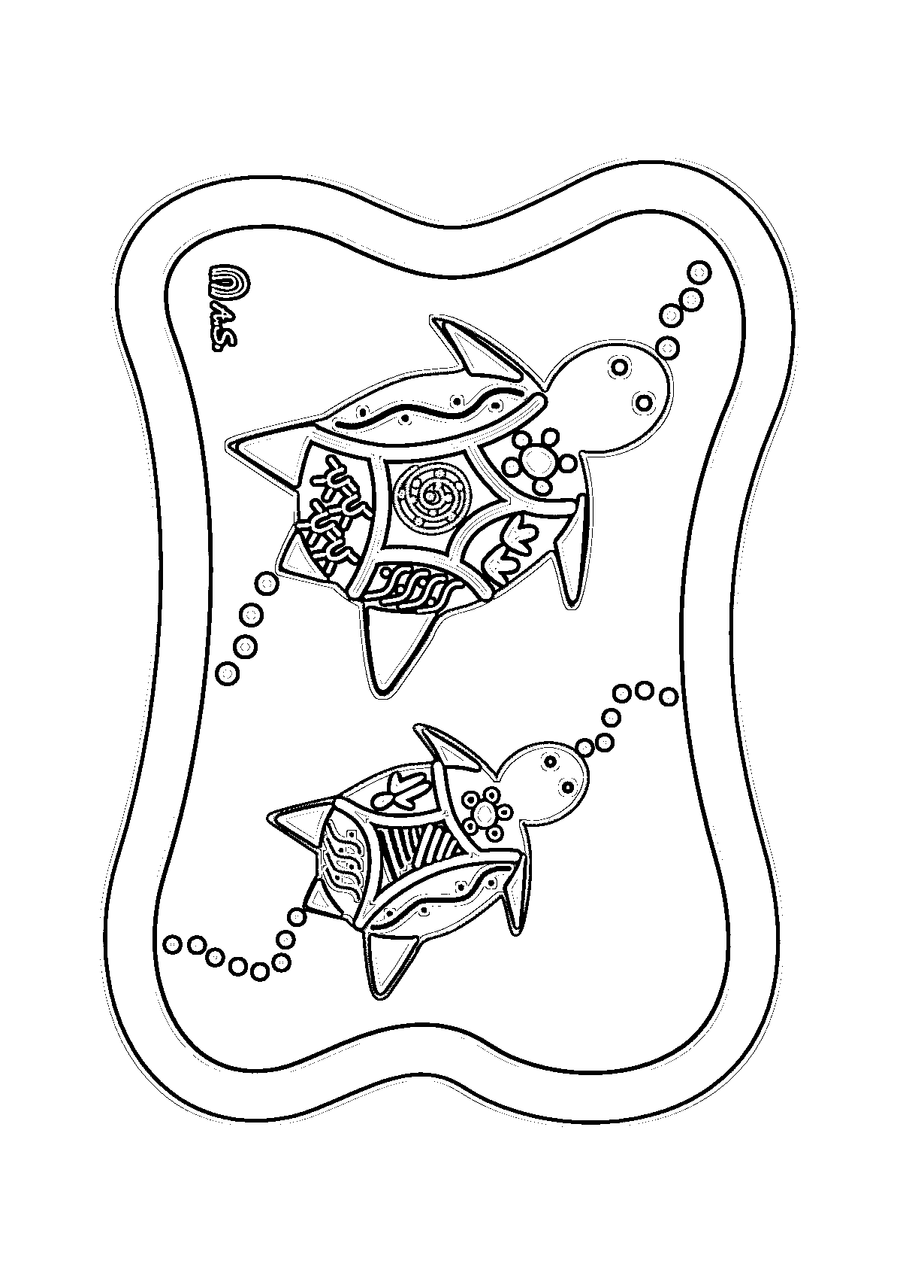
This Aboriginal Colouring In Sheet is a Gift from Annette Sax, Taungurung Artist.
Annette Sax holds © Copyright and does not give permission for her Aboriginal Art to be changed or adapted for any other purpose. She hopes that Children and Adults enjoy the experience of Colouring !
Visit our Website: www.yarnstrongsista.com

Slide 3
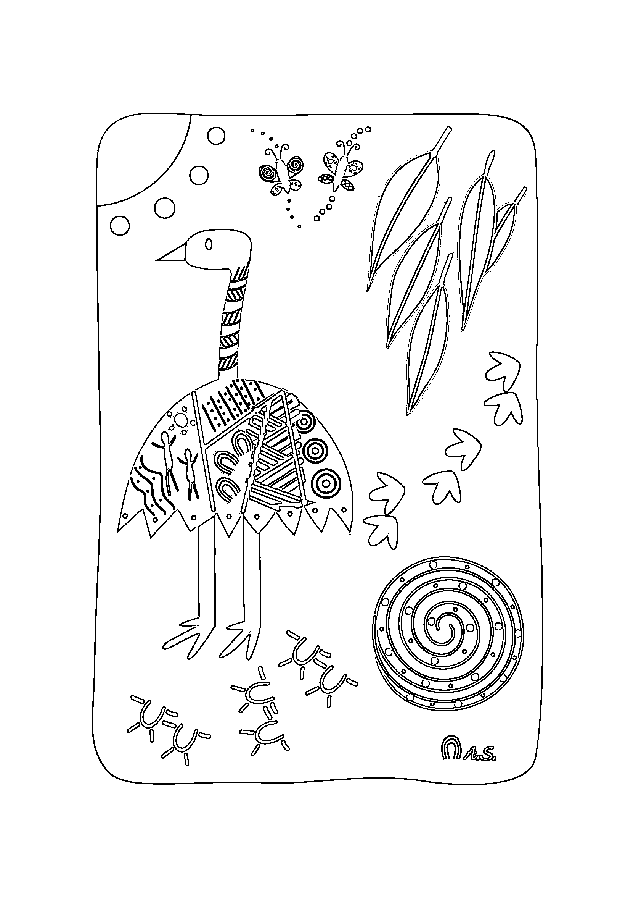
This Aboriginal Colouring In Sheet is a Gift from Annette Sax, Taungurung Artist.
Annette Sax holds © Copyright and does not give permission for her Aboriginal Art to be changed or adapted for any other purpose. She hopes that Children and Adults enjoy the experience of Colouring !
Visit our website: www.yarnstrongsista.com

